Slide 1

Riley Equine Center
Understanding Cerebral palsy, Autism, Anxiety & Depression
By: Benjamin Fite

Slide 2

Overview
What is Therapeutic Horse riding?
Cerebral Palsy
Attention Deficit Disorder
Autism
Anxiety Disorders
Depression

Slide 3
Therapeutic Riding & Hippotherapy
Therapeutic Riding
The use of a horse and equine based activities to achieve therapeutic goals including cognitive, physical, social, educational, and behavioral goals (Riley, 2021)
Hippotherarpy
Engages sensory, neuromotor, and cognitive systems to promote functional outcomes (Riley,2021)
How occupational, physical, and speech- language therapies are used combined with evidence-based practice and clinical reasoning in the purpose of equine movements (Riley, 2021)
Used first during WW1 in Germany
First study reported benefits in 1875, by a French physician (Riley, 2021)
Determined it was helpful in treatment of certain neurological disorders (Riley, 2021)
Germany and Switzerland have developed and established most of the hippotherapy medical equine services (Riley, 2021)

Slide 4
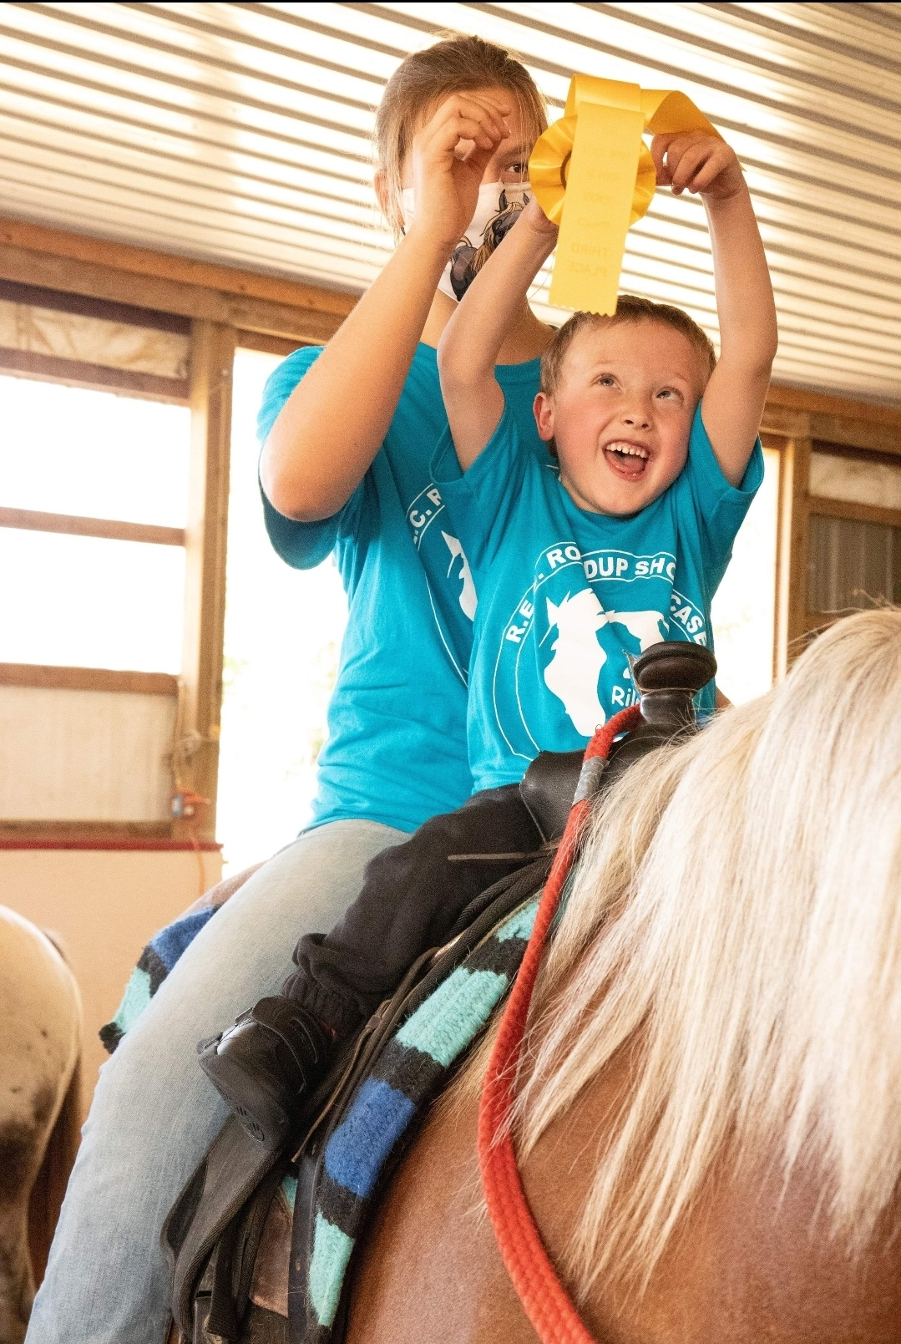
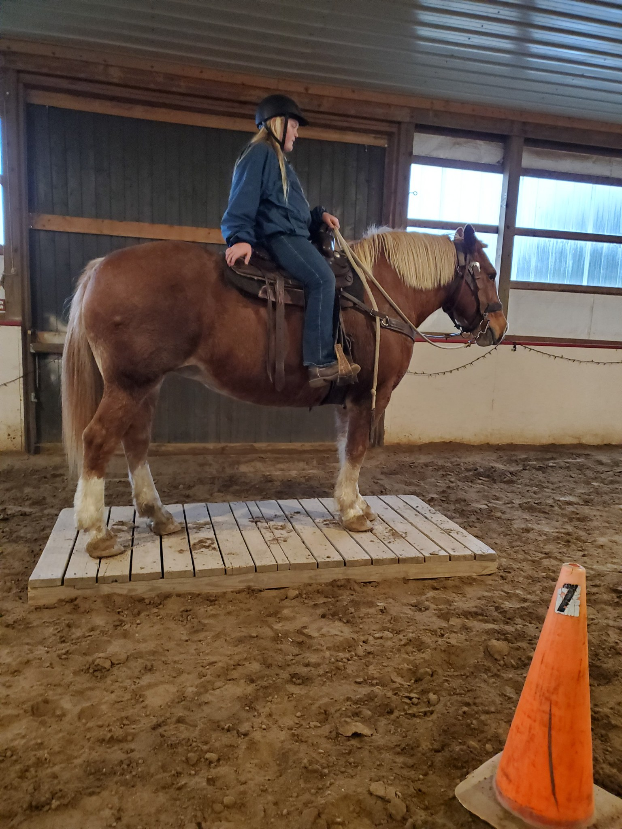
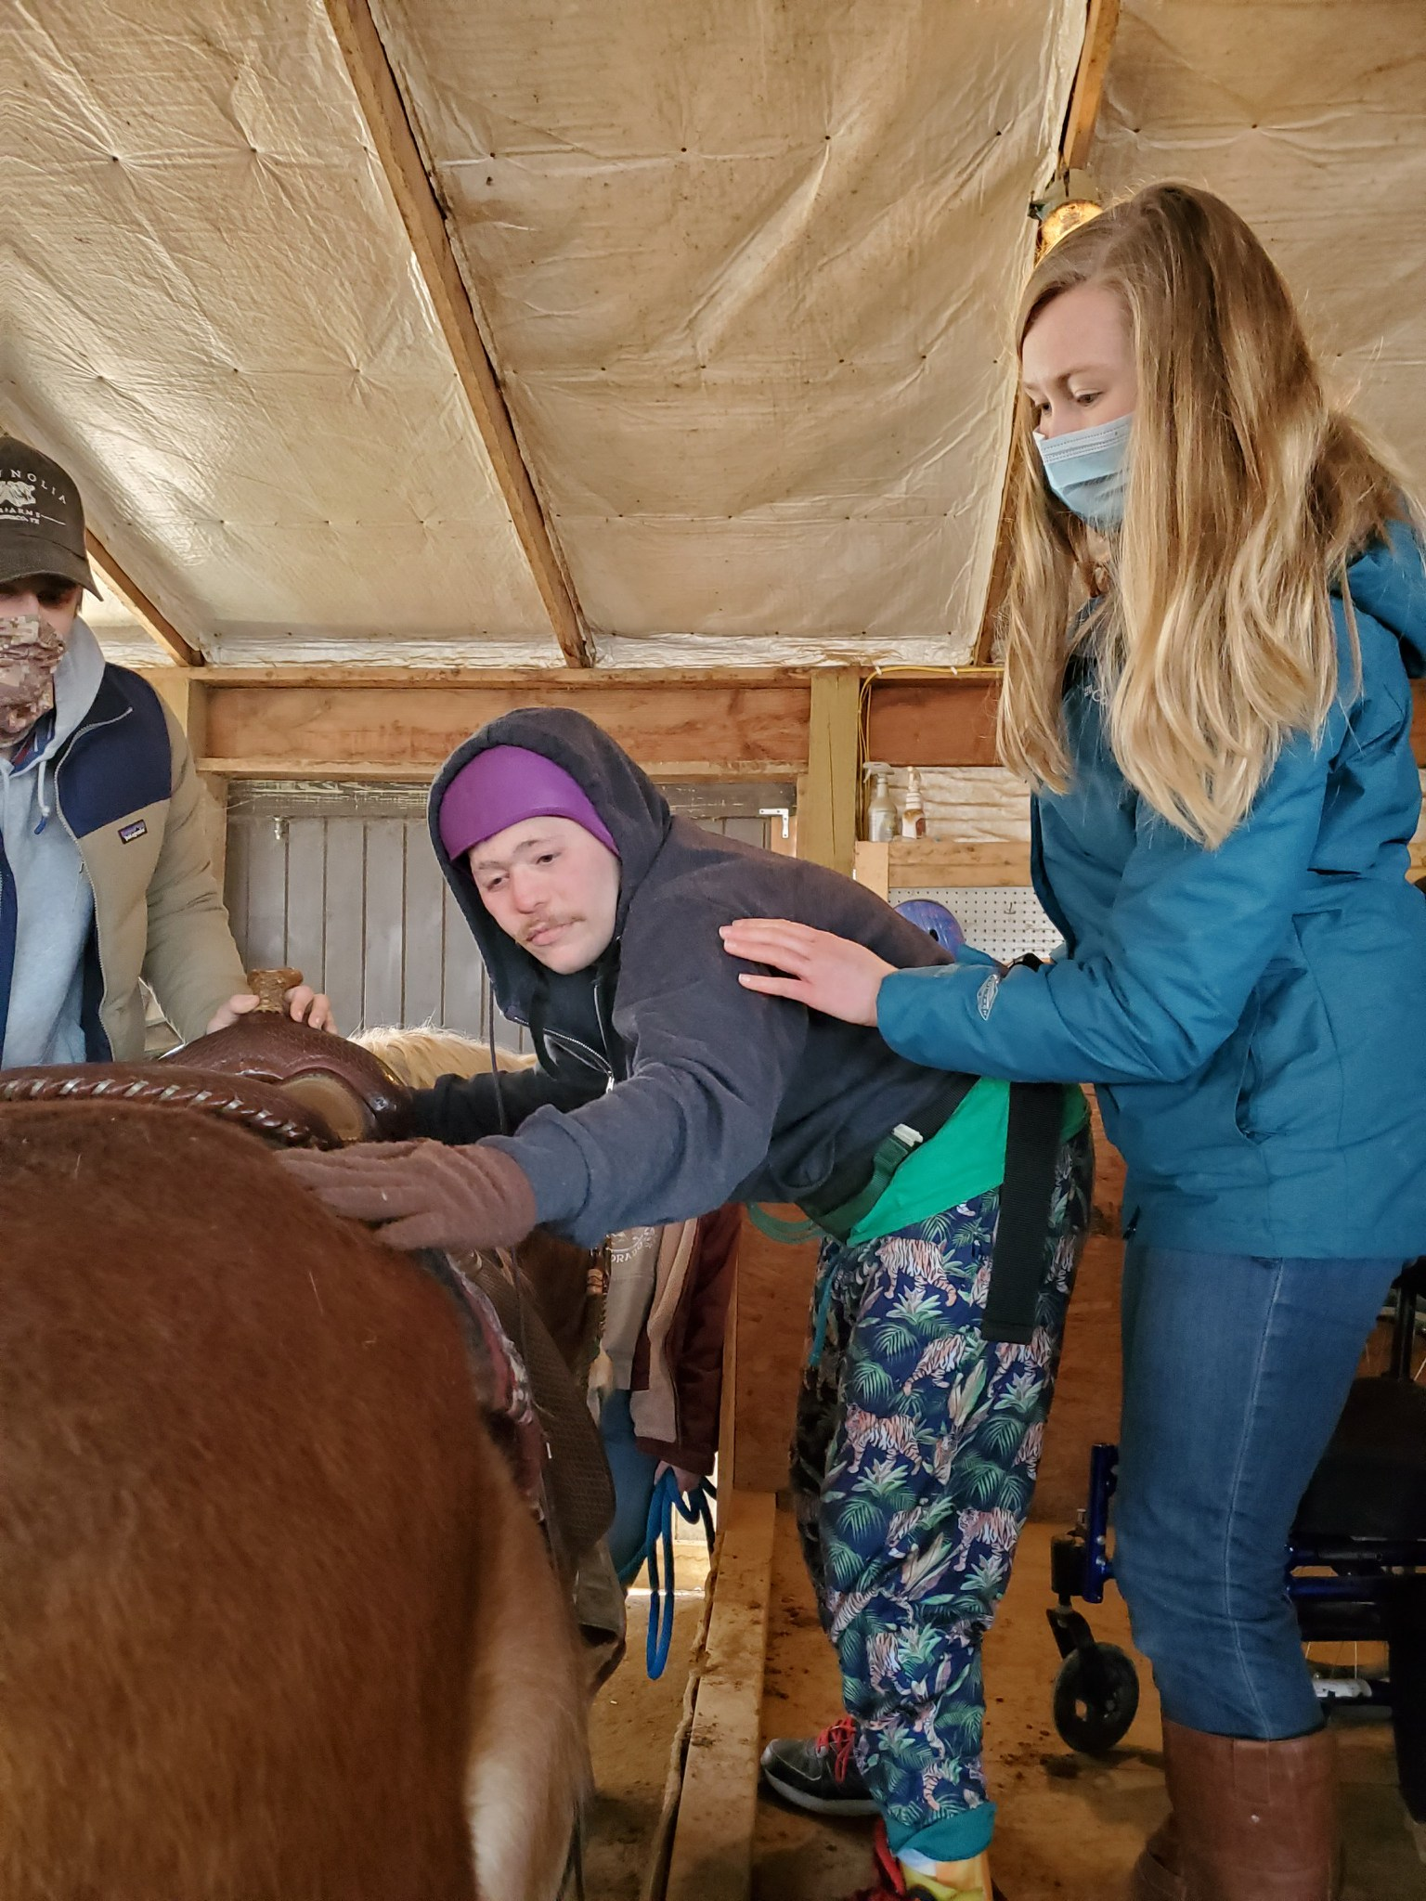

Slide 5
What Individuals Benefit?
Cerebral Palsy
Attention Deficit Disorders
Autism
Anxiety/ Depression Disorders
And Many More

Slide 6
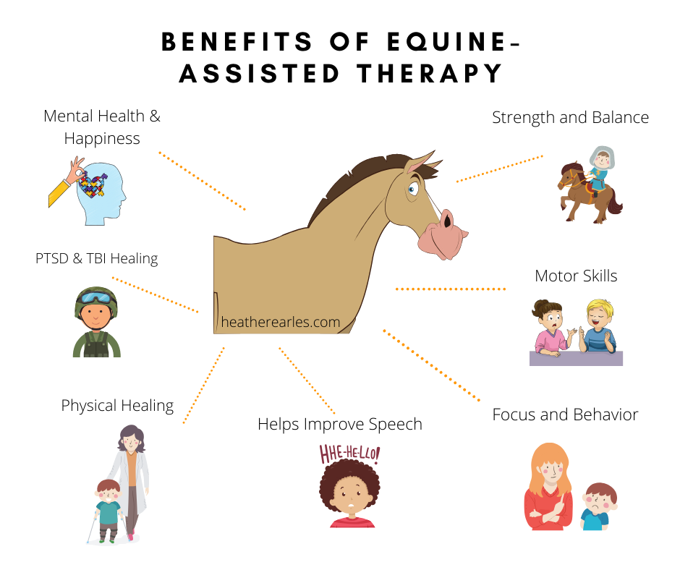

Slide 7
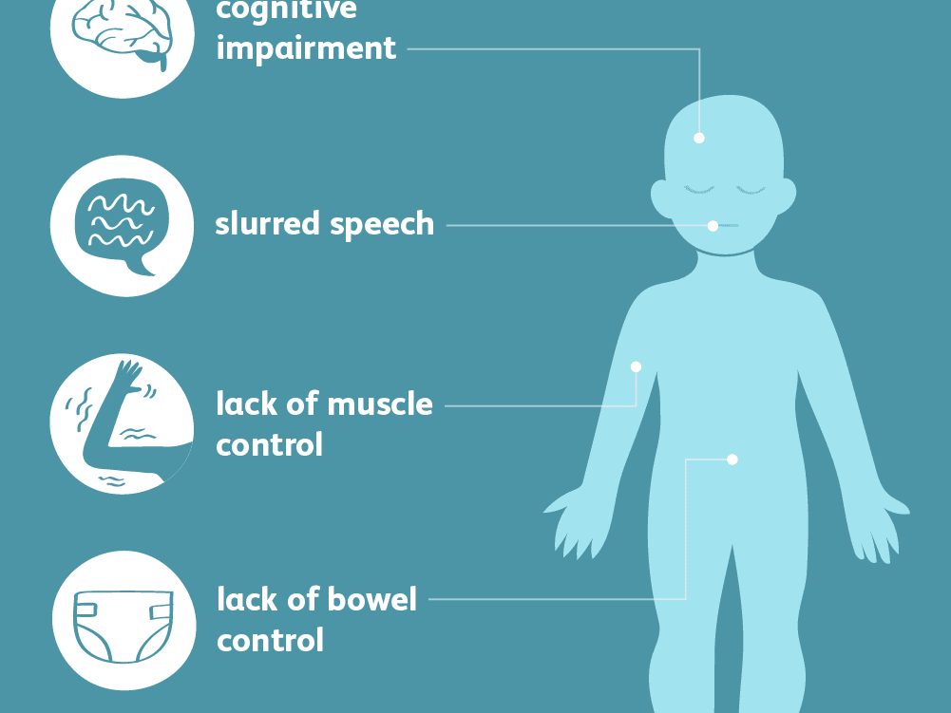

Cerebral Palsy
“is a group of disorders that affect a person’s ability to move and maintain balance and posture” (“What is Cerebral Palsy”, 2020)
“CP is caused by abnormal brain development or damage to the developing brain that affects a person’s ability to control his or her muscles” (“What is Cerebral Palsy”, 2020)

Slide 8
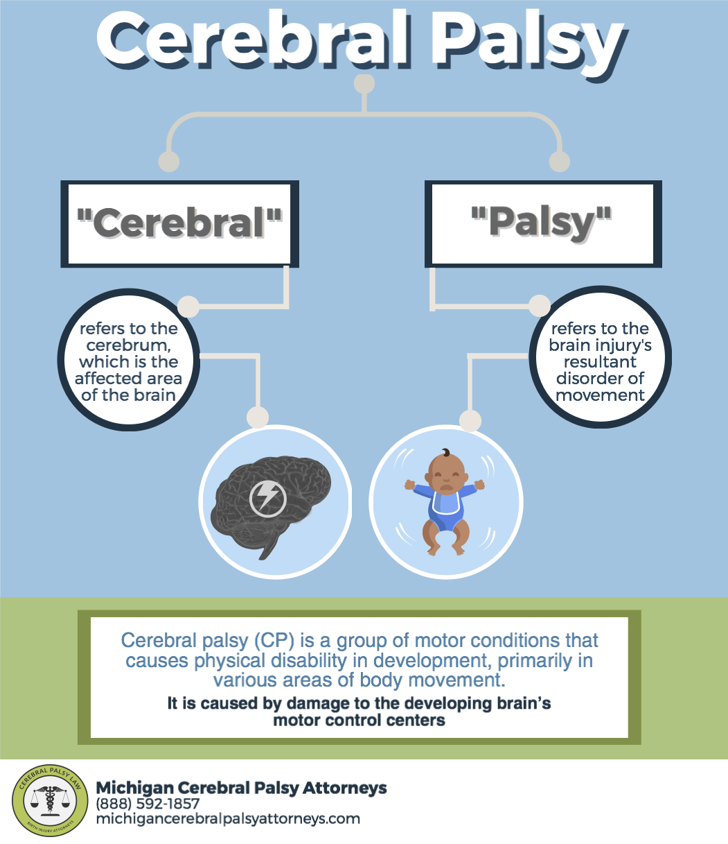
Four Most Common Forms
Spastic Cerebral Palsy:
  The most common form (80%)
  Increases muscle tone which stiffens muscles and causes movement to be difficult
  Can effect in diplegia, hemiplegia, or quadriplegia
Dyskinetic Cerebral Palsy:
  Makes it difficult to control arms, hands, feet, and legs
  Are slow and uncontrollable, or rapid and jerky
Ataxic Cerebral Palsy:
  Balance and Coordination Problems
Mixed Cerebral Palsy:
  Condition of multiple forms of cerebral palsy
  Spastic-dyskinetic
What is cerebral palsy? (2020, December 31). Retrieved April 09, 2021, from https://www.cdc.gov/ncbddd/cp/facts.html

Slide 9
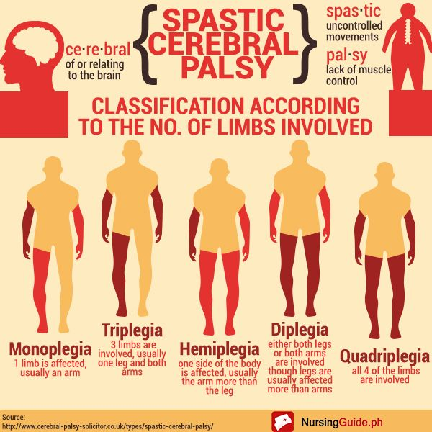

Slide 10
Benefits of therapeutic riding and CP
“Since CP can affect a person’s motor functions, horse riding has been found to help improve functions such as strength, posture, balance, and coordination”(Stern, 2021)
Increased cognitive benefits including improved attention and sensory input (Stern, 2021)
Both psychological and emotional benefits have been noted due to an increase in social interaction and self esteem (Stern, 2021)

Slide 11

Attention Deficit Disorders
“is a neurological disorder that causes a range of behavior problems such as difficulty attending to instruction, focusing on schoolwork, keeping up with assignments, following instructions, completing tasks and social interaction” (kidsandhorses, 2017)
To the untrained eye, individuals with attention deficit disorder may be mistaken for lazy and have bad behavior (kidsandhorses, 2017)

Slide 12
Unknown Facts of ADD and Equine Therapy
“6.4 million children have been diagnosed between the ages of 4 and 17 with ADD” (kidsandhorses, 2017)
ADD can interfere with children's social and educational development (kidsandhorses, 2017)
More often than most, medicine is not a significant treatment for children with this problem, but a mask (kidsandhorses, 2017)
Horse’s give those individuals with ADD the ability to observe their own behaviors because horses often mimic behavior (kidsandhorses, 2017)
“Offers children the ability to analyze and reflect on behavior and increase attention span and reduce hyperactivity” (kidsandhorses, 2017)

Slide 13
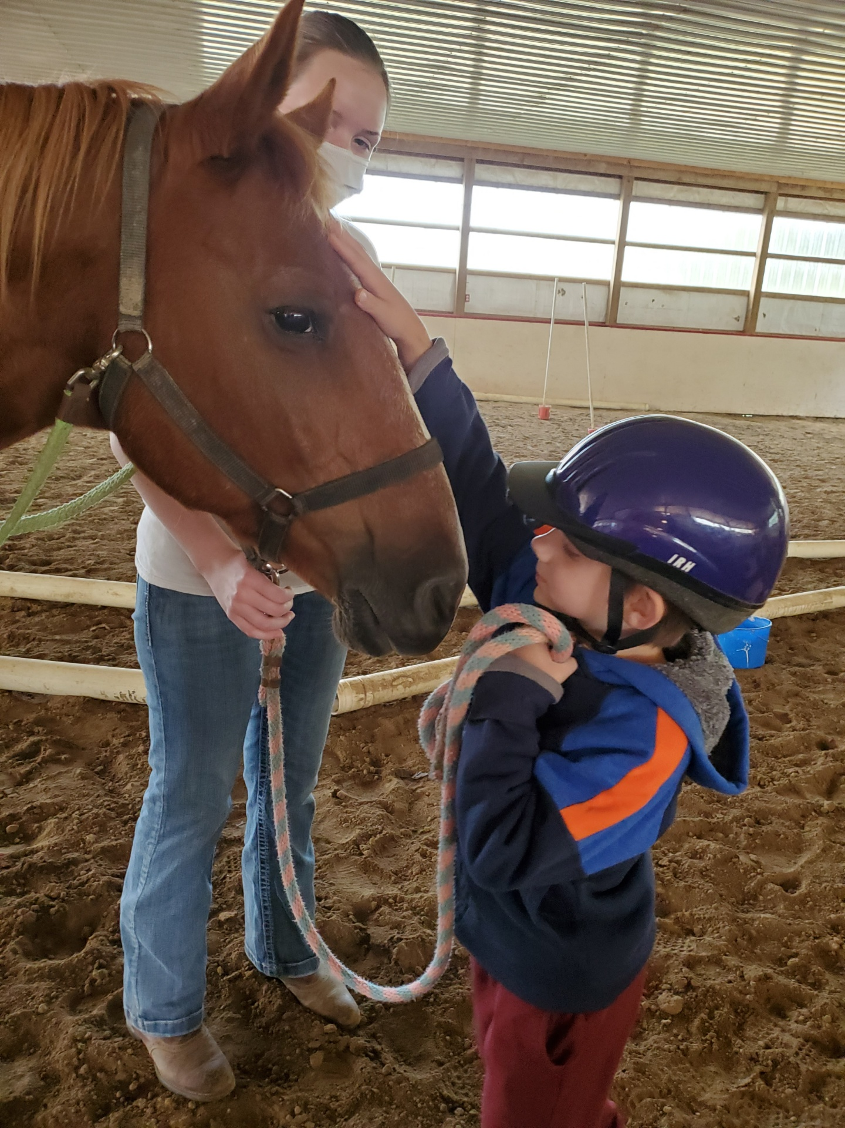
Horse riding can improve the lives of individuals with ADD for several reasons
  Riding can decrease anxiety, depression, and aggressive behaviors
  “Riding can build an individual’s sense of personal responsibility and satisfaction with completing a task” (kidsandhorses, 2017)
  Riding improves motor skills, and when in a group setting may enhance social interactions (kidsandhorses, 2017)

Slide 14
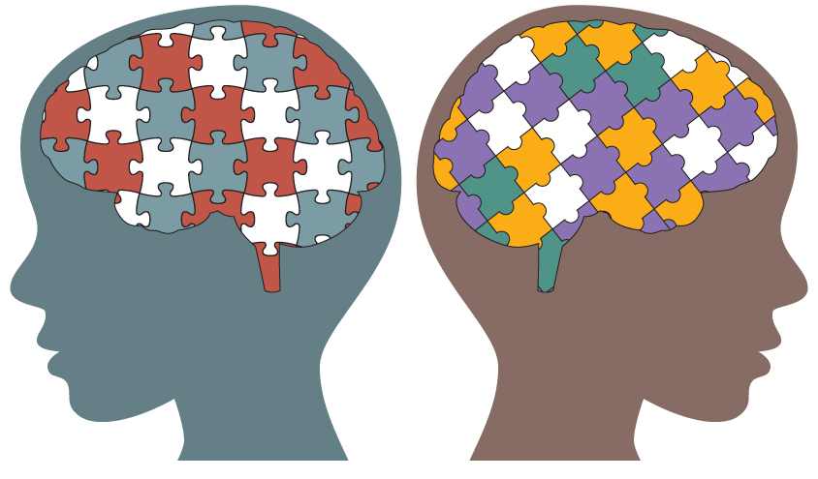
Autism
“is a developmental disability that affects an individual's ability to communicate (e.g., the ability to use language to express one's needs) and the ability to engage in social interaction (e.g., the ability to engage in joint attention)” (Alpine learning community, 2021)
“As of 2016, ASD affects 1 in 68 children. 1 in 42 boys and 1 in 189 girls” (Alpine learning community, 2021)
“ASD is 4 times more common in males than females” (Alpine learning community, 2021)

Slide 15
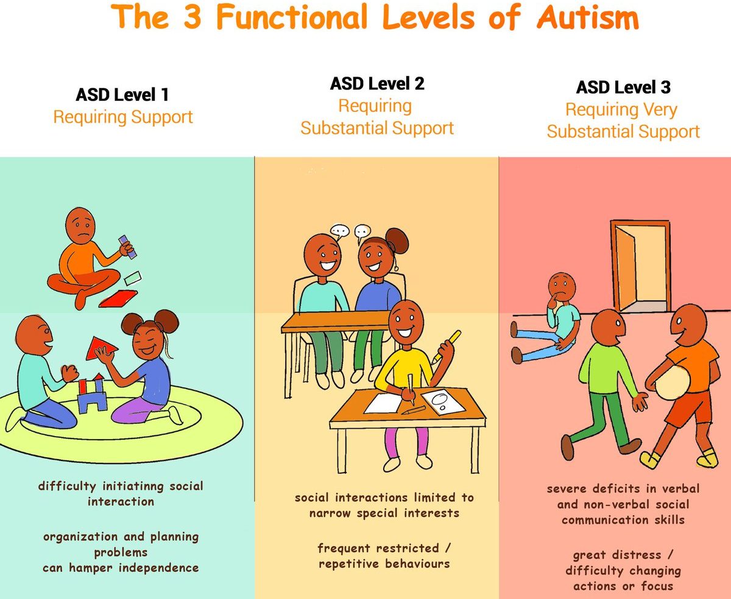

Slide 16
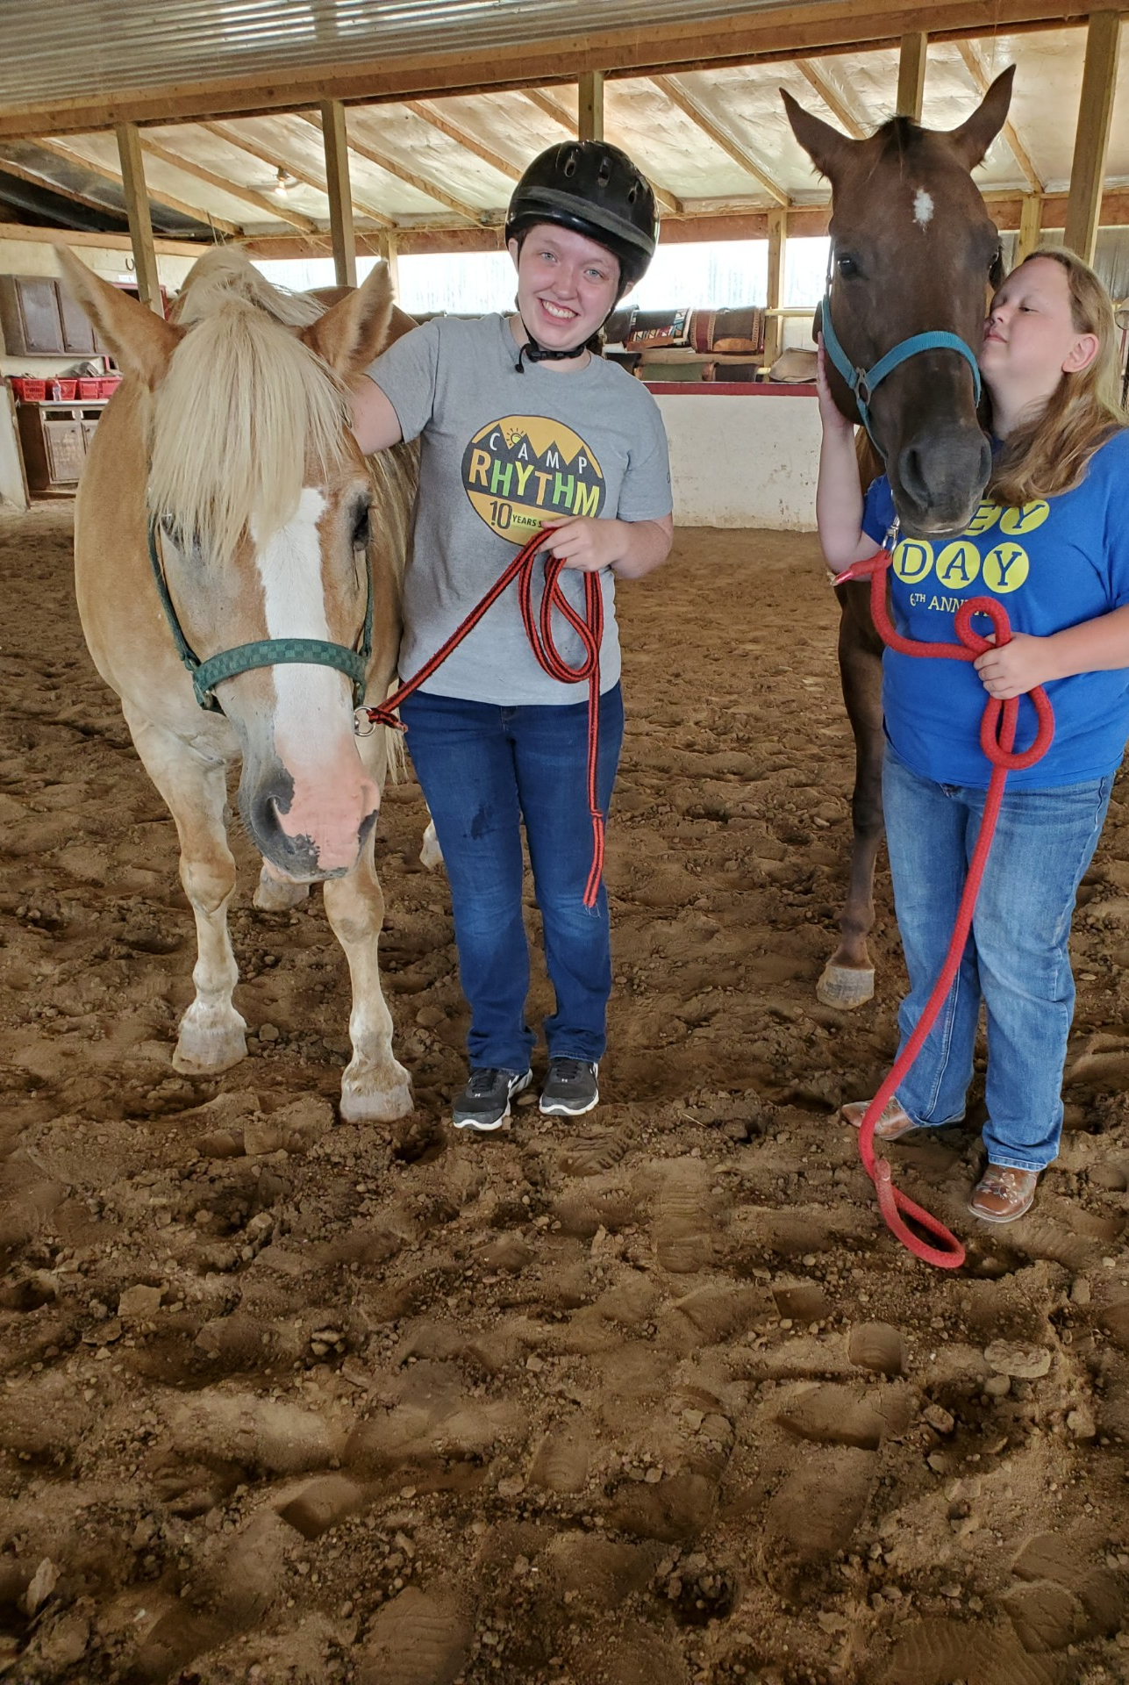
Benefits contributed with Autism
It has been found that autistic individuals are able to develop emotional bonds while riding, furthermore, this teaches the individuals a successful and healthy relationship (asdf, 2021)
Group setting has been proven to increase communication and following directions (asdf, 2021)
Communication skills are further enhanced with commands while riding
“Riding stimulates a person’s sensory preceptors, which can improve an autistic individual’s overall wellbeing” (asdf, 2021)

Slide 17
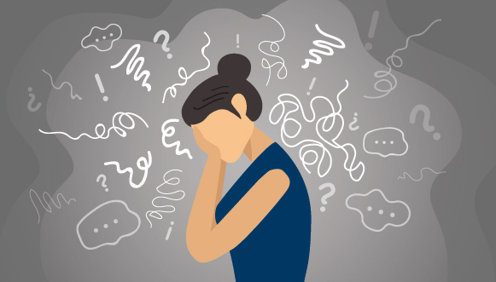
Anxiety Disorders
First, it’s important to know that everyone has anxiety, and it’s our bodies natural way of dealing with stress (Clarke, 2020)
Anxiety is an emotion that is normal, but should not take over our life’s
However, an anxiety disorder is characterized by symptoms lasting longer than six months or extreme feelings of anxiety which interfere with our own life (Clarke, 2020)
Anxiety is a form of fear, and in disorders becomes debilitating (Clarke, 2020)
Anxiety disorders are the most common emotional disorder and can effect anyone at anytime, and if left untreated become worse (Clarke, 2020)

Slide 18
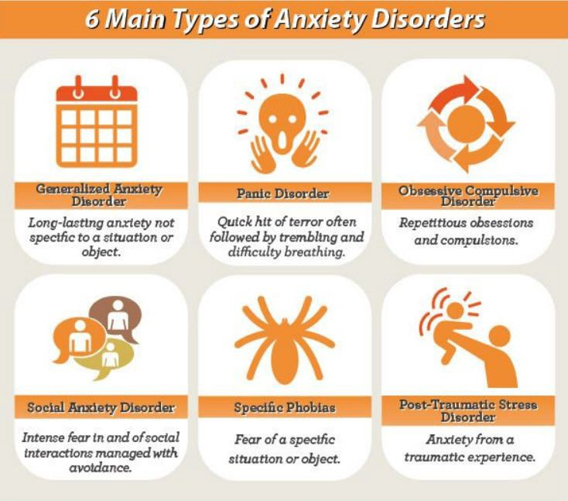
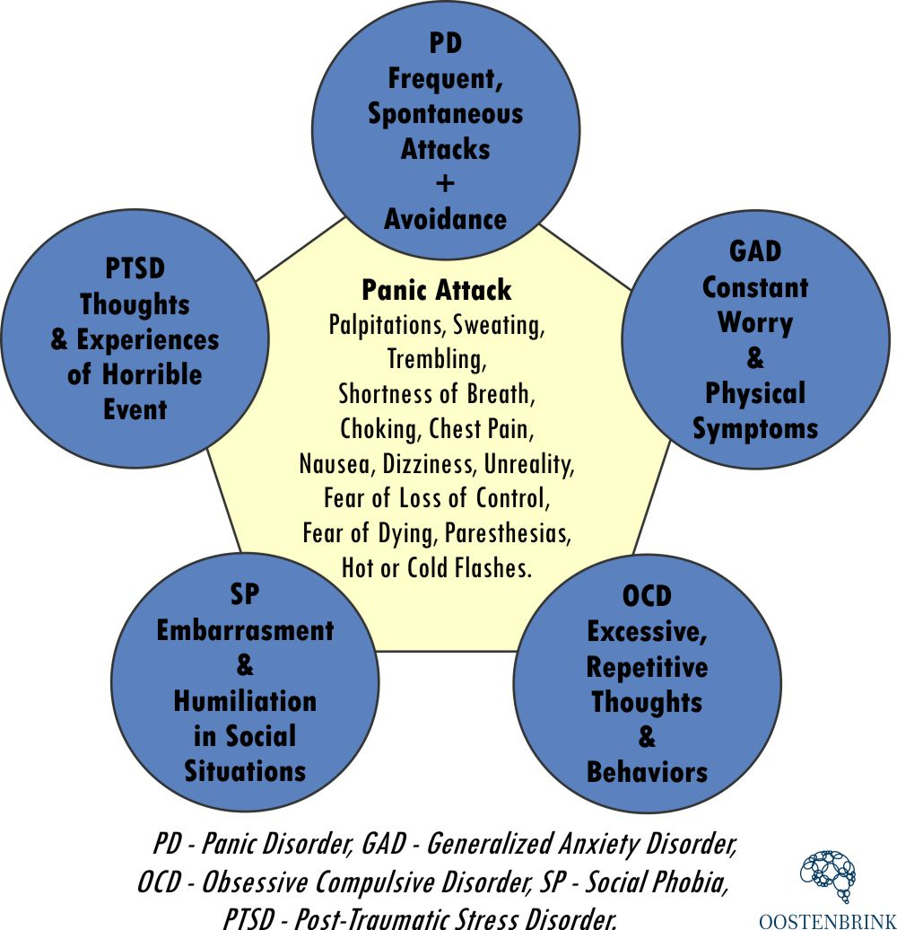
Types of Anxiety Disorders

Slide 19

Depression
Depression (major depressive disorder) is a common and serious medical illness that negatively affects how you feel, the way you think, and how you act (Torres, 2020)
Feeling sad or having a depressed mood (Torres, 2020)
Loss of interest or pleasure in activities once enjoyed (Torres, 2020)
Changes in appetite — weight loss or gain unrelated to dieting (Torres, 2020)
Trouble sleeping or sleeping too much (Torres, 2020)
Loss of energy or increased fatigue (Torres, 2020)
“Increase in purposeless physical activity (e.g., inability to sit still, pacing, handwringing) or slowed movements or speech (these actions must be severe enough to be observable by others” (Torres, 2020)
Feeling worthless or guilty (Torres, 2020)
Difficulty thinking, concentrating or making decisions (Torres, 2020)
Thoughts of death or suicide (Torres, 2020)

Slide 20
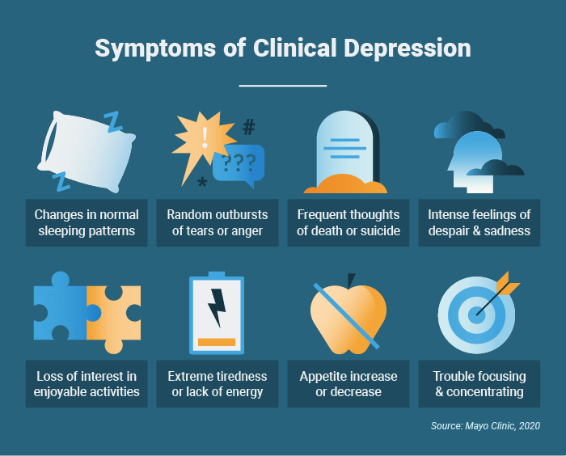

Slide 21
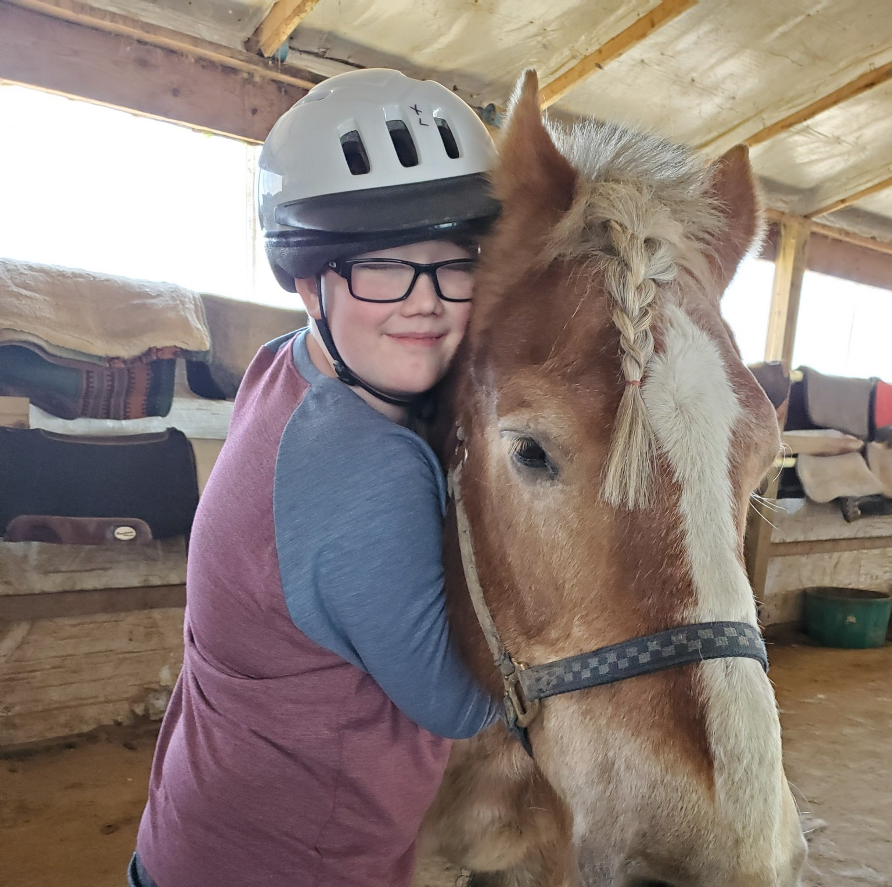

Benefits
Horses offer sense of peace in time of unrest
Calm and Unbiased
Emotional Awareness
Self Esteem
Social Awareness
Relationships
Providing the horse their essential needs gives patients therapeutic benefits

Slide 22
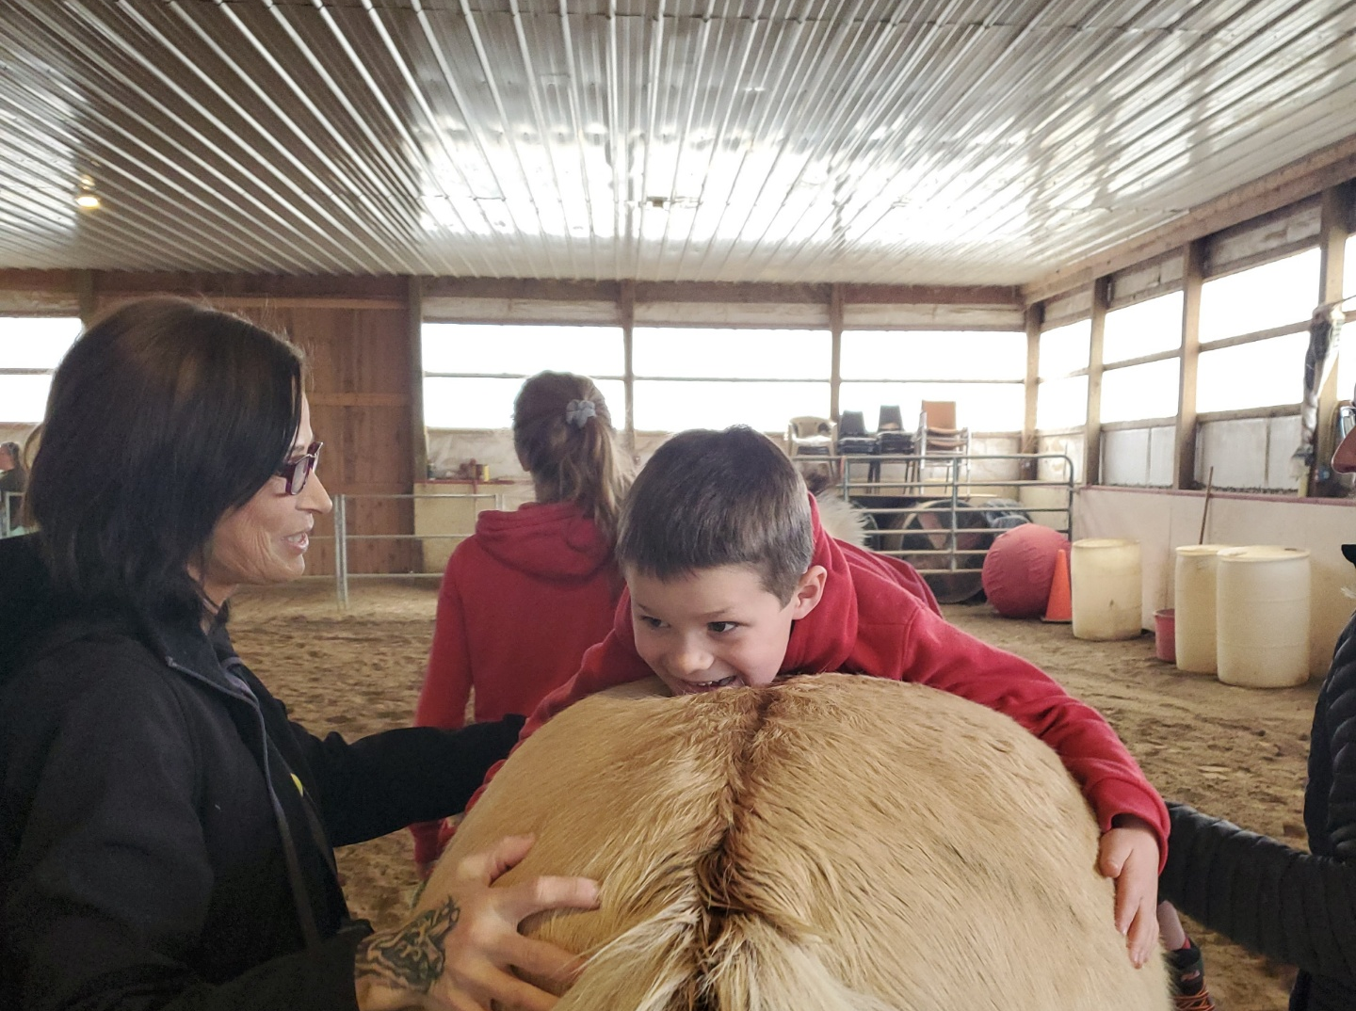
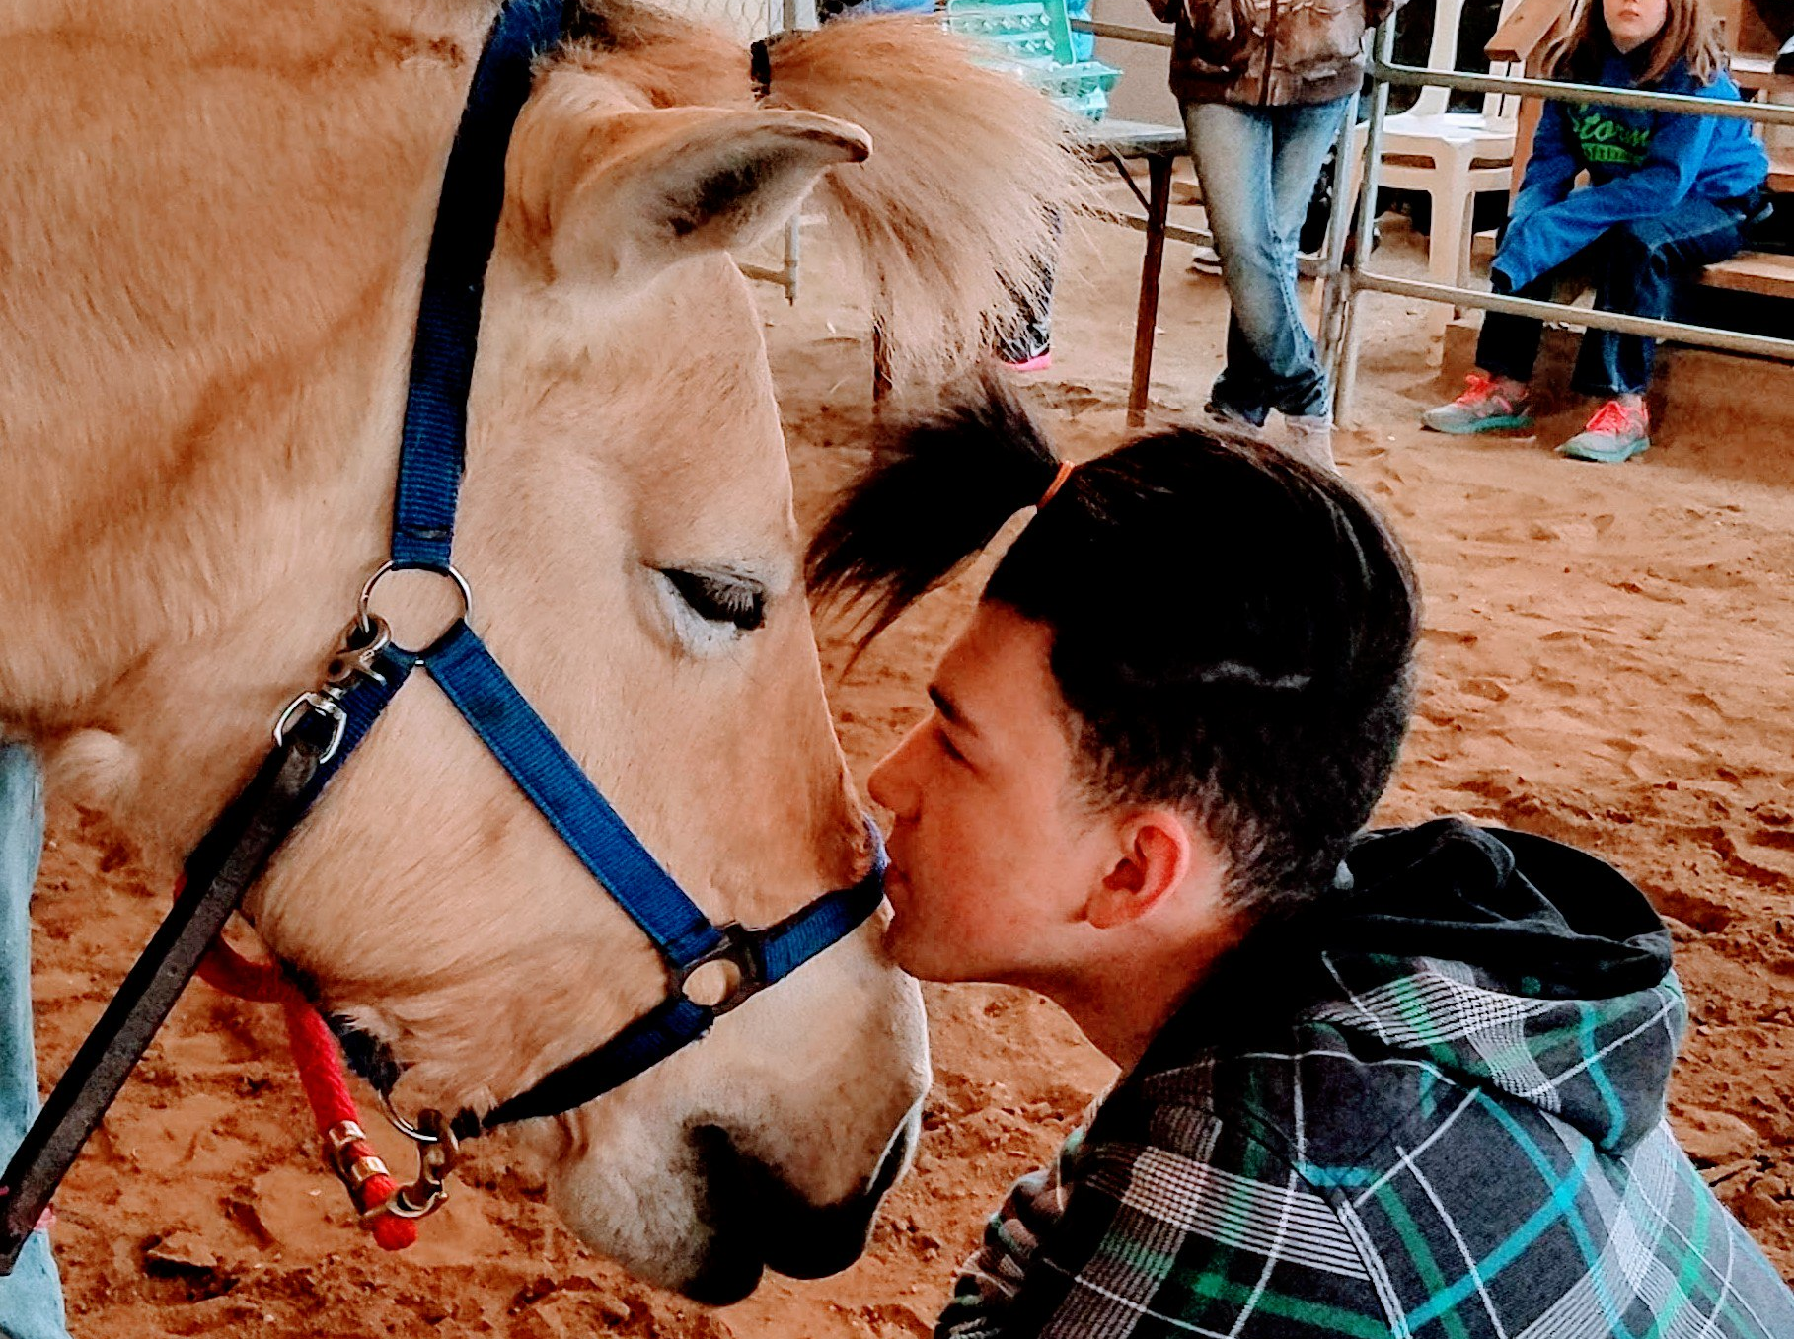
Benefits
Feedback and Mirroring
  Horse’s are keen observers and understand our movement and emotions, which allows them to mirror our interaction (Clarke, 2020)
  This gives riders a sense of connection and sense of understanding (Clarke,2020)
Managing Vulnerability
  Assertiveness
  Confidence
  Trust in self and other’s
  Empathy
  Impulse Control

Slide 23
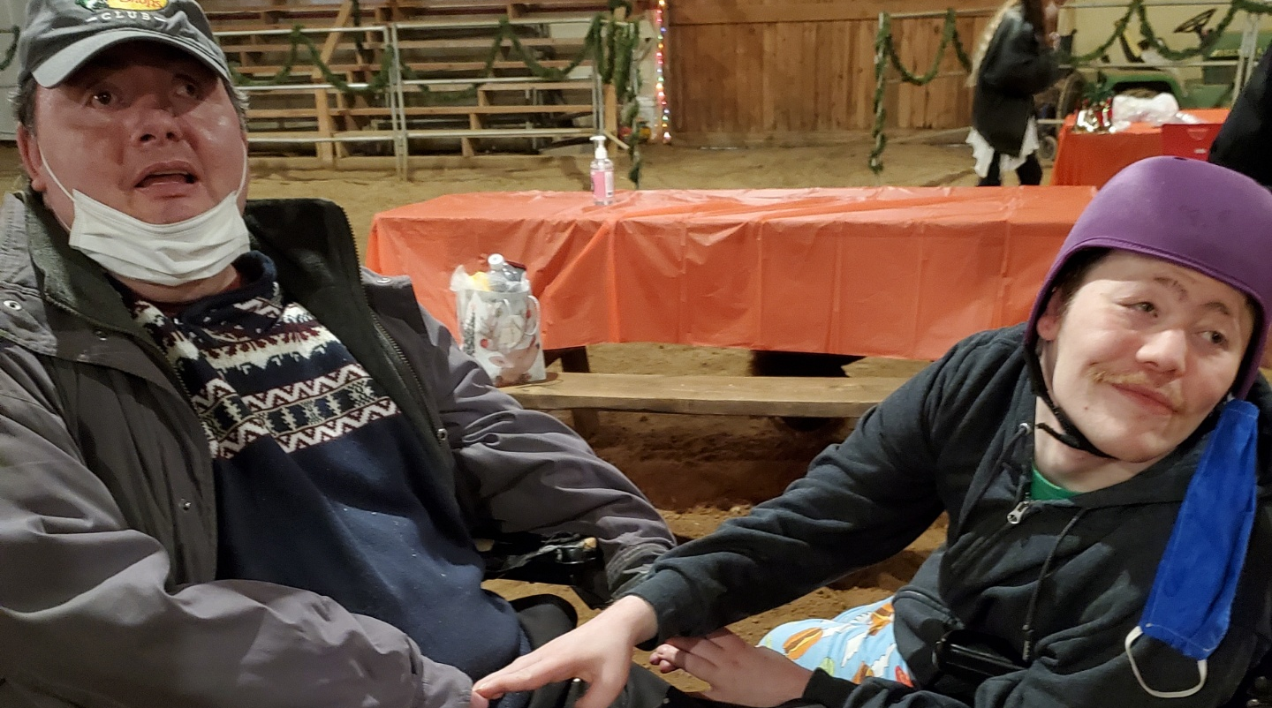
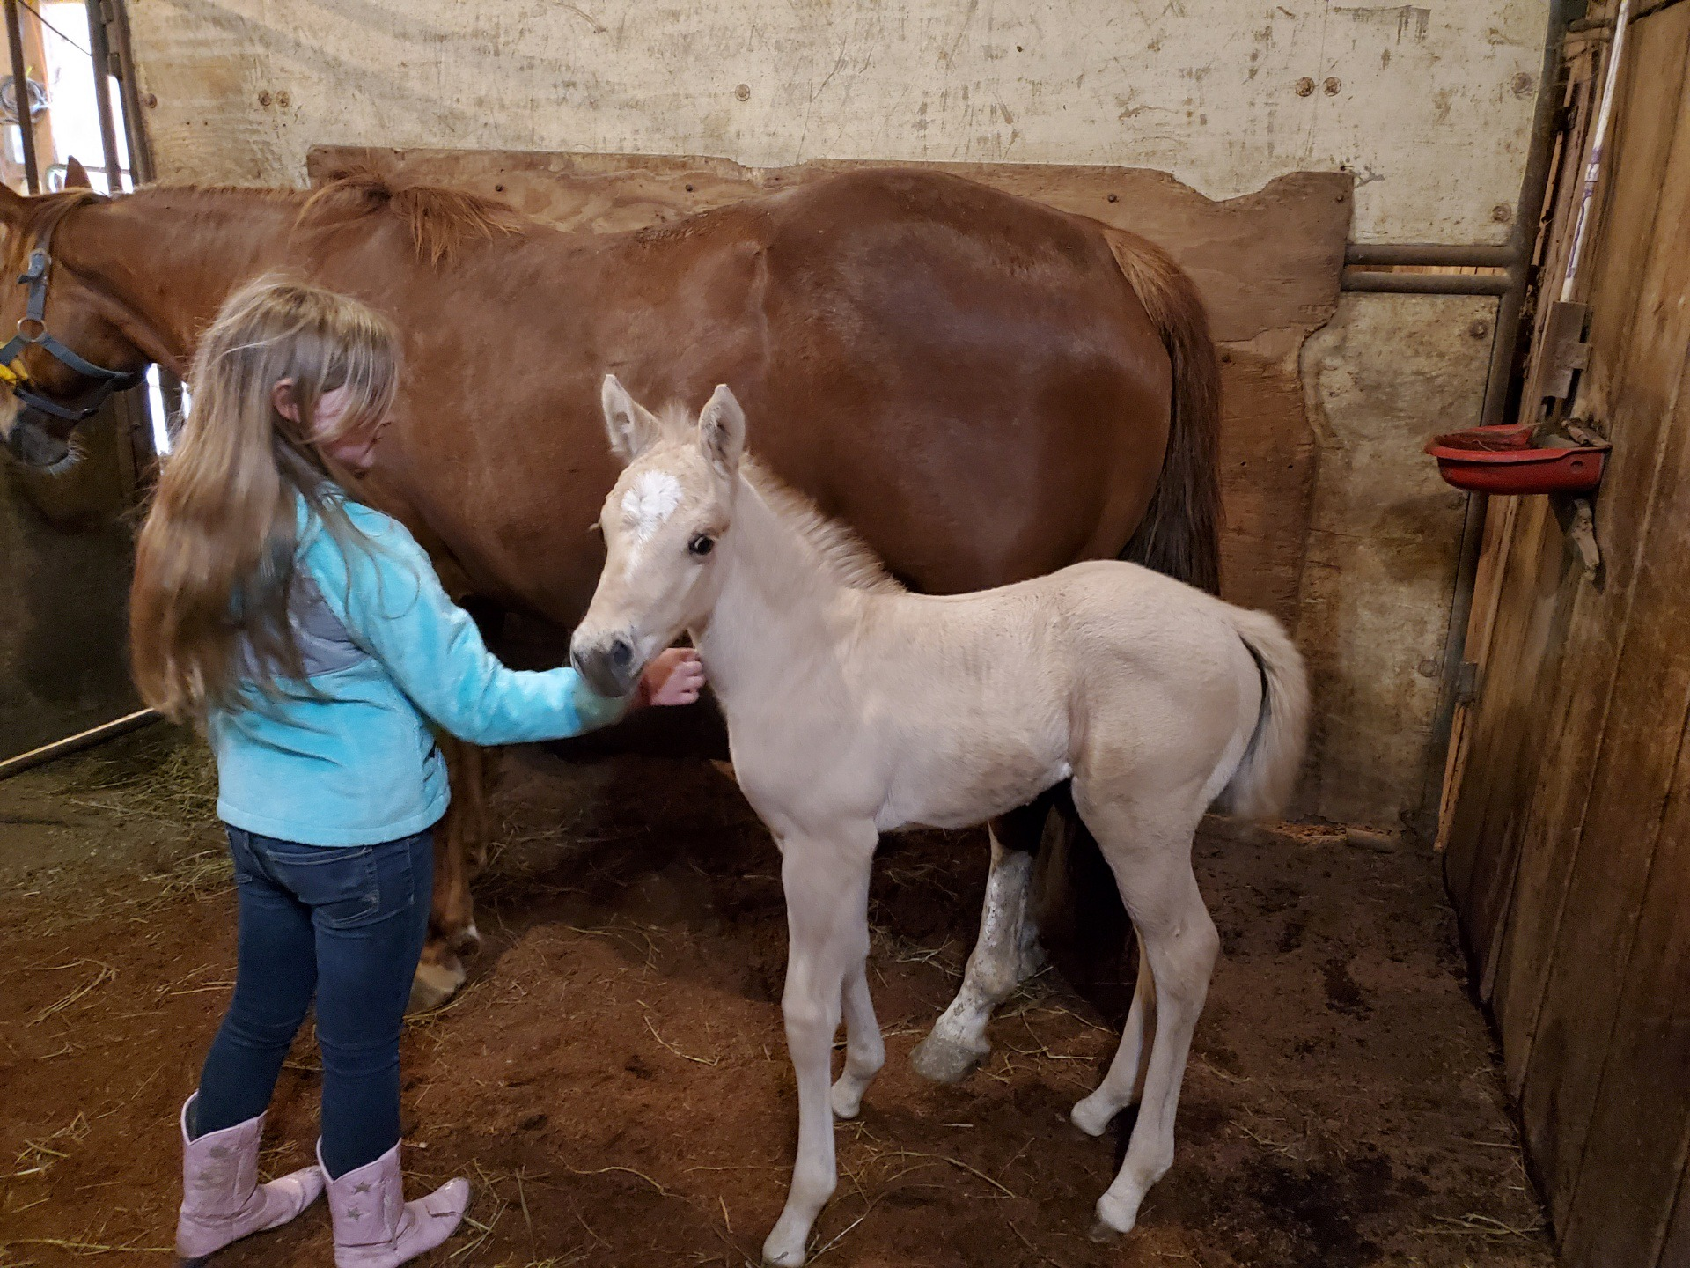
More Benefits
Emotional Awareness
Self Esteem
Social Awareness
Relationships
Providing the horse their essential needs gives patients therapeutic benefits (Clarke,2020)

Slide 24
References
What is cerebral palsy? (2020, December 31). Retrieved April 09, 2021, from https://www.cdc.gov/ncbddd/cp/facts.html
Stern, K. A. (2021). Hippotherapy. Retrieved April 09, 2021, from https://www.cerebralpalsy.org/about-cerebral-palsy/treatment/therapy/hippotherapy
Kidsandhorses. (2017, October 17). Letting kids with Adhd take the reins. Retrieved April 09, 2021, from https://kidsandhorses.org/letting-kids-with-adhd-take-the-reins-2/
What is autism spectrum disorder (asd)? (n.d.). Retrieved April 09, 2021, from https://www.alpinelearninggroup.org/What-is-ASD.php?gclid=Cj0KCQjwsLWDBhCmARIsAPSL3_0rPiw0DqTCLivs4ydWHWN36oJ7jGMmEP4qO2s87Sru_DFR4UvmHggaAvwWEALw_wcB
Jodi Clarke, M. (2020, June 22). Equine therapy as mental health Treatment: How it's used. Retrieved April 09, 2021, from https://www.verywellmind.com/equine-therapy-mental-health-treatment-4177932

Slide 25
References
Torres, F. (2020, October). What is depression? Retrieved April 09, 2021, from https://www.psychiatry.org/patients-families/depression/what-is-depression?_ga=1.168853089.1797803160.1482157834
Riley, Bonnie. “Riley Equine Center: Boonville, MO 65233.” Riley Equine Center | Boonville, MO 65233, rileyequinecenter.homestead.com/.

Slide 26
Picture References
https://www.houstonmethodist.org/blog/articles/2020/dec/what-anxiety-feels-like-and-why-it-happens/
https://www.talkspace.com/blog/the-stigma-of-depression/
https://baxleyjames.medium.com/i-have-generalized-anxiety-disorder-i-survived-2cf7fb4ed62f
https://www.oostenbrink.co.za/27-anxiety-panic-disorde
https://www.houstonmethodist.org/blog/articles/2020/dec/what-anxiety-feels-like-and-why-it-happens/
https://twitter.com/gtbank/status/1155442435121696769
https://parenting.firstcry.com/articles/attention-deficit-hyperactivity-disorder-adhd-in-children/

Slide 27
Picture References
https://cerebralpalsy.org.nz/research/what-is-cerebral-palsy/
https://www.verywellhealth.com/cerebral-palsy-signs-symptoms-and-complications-4160369
https://www.zee5.com/zee5news/world-cerebral-palsy-day-2020-date-what-is-cerebral-palsy-know-symptoms-causes-and-treatment-of-this-neurological-disorder
https://www.pinterest.com/pin/189291990577791075/
https://www.pinterest.ph/pin/127789708155337841/
https://www.spectrumnews.org/news/an-overdue-query-in-autism-science-what-exactly-is-autism/

